Slide 1
Impulse Notes

Slide 2
Impulse
A force sustained for a long time produces more change in momentum than does the same force applied briefly.
Both force and time are important in changing an object’s momentum.

Slide 3
Impulse Changes Momentum
The change in momentum depends on the force that acts and the length of time it acts.
If the momentum of an object changes, either the mass or the velocity or both change.
The greater the force acting on an object, the greater its change in velocity and the greater its change in momentum.

Slide 4

Impulse Changes Momentum
When you push with the same force for twice the time, you impart twice the impulse and produce twice the change in momentum.

Slide 5
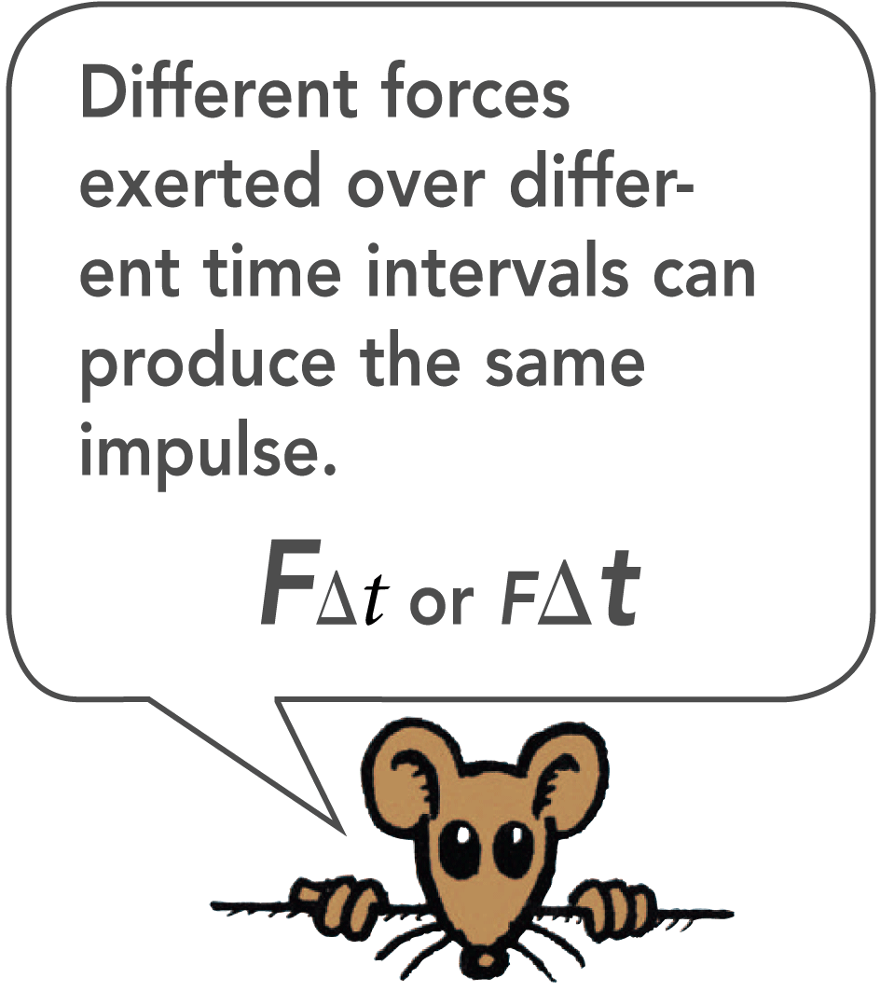
Calculating Impulse
The quantity force × time interval is called impulse.
impulse = F × t
The greater the impulse exerted on something, the greater will be the change in momentum.
impulse = change in momentum
Ft = ∆(mv)

Slide 6
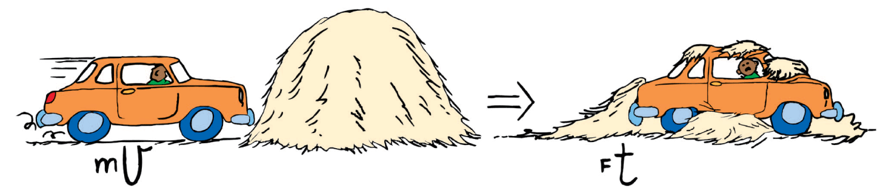
Evaluating Impulse
If the change in momentum occurs over a long time, the force of impact is small.

Slide 7
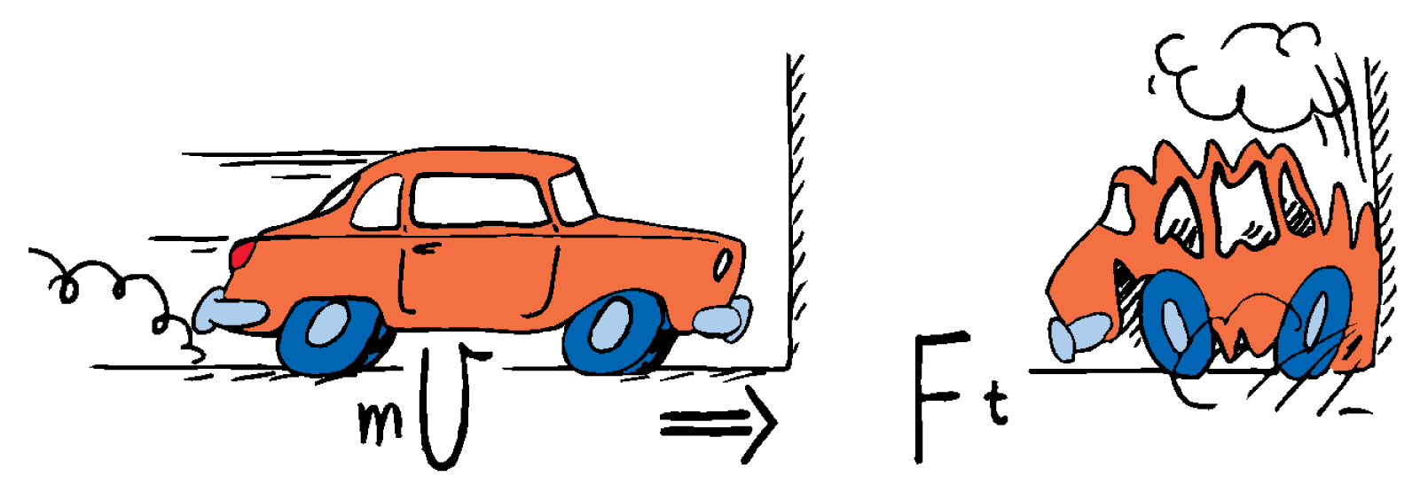
Evaluating Impulse
If the change in momentum occurs over a short time, the force of impact is large.

